Slide 1

Team 09 Driver injury severity analysis in automobile crashes

Slide 2


Team Members
Naveen Varma Patsamatla
Deva Darshita Pillai

Slide 3
Executive Summary
We employed six prevalent predictive models—decision tree, random forest, gradient boosted tree, Artificial neural networks -MLP, logistic regression, and naive bayes using KNIME analytics platform.
Found Random forest has best accuracy of 81% and produced balanced results
Finally , we did variable importance using sensitivity analysis study, showing us which crash-related factors matter most for different injury severity levels.

Slide 4
CRISP - DM Cross-Industry Process for Data Mining
It’s a structured approach for Data Mining Projects.
it's a globally proven approach shaped by over 200 organizations.
Open standard, accessible for universal use.
Versatility, allowing its applications in various analytical contexts.

Slide 5







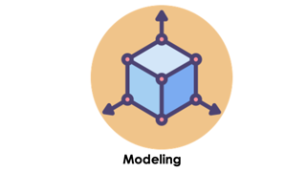


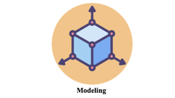

CRISP - DM

Slide 6

Business Understanding

Slide 7

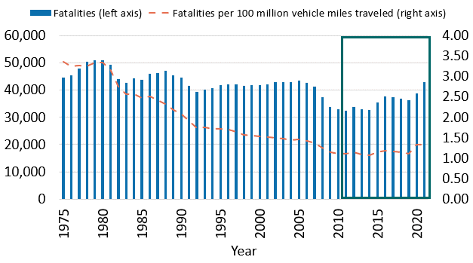
Business Understanding:
Despite incredible technological strides, the challenge of road safety persists, costing the U.S. a staggering $800 billion annually in road accidents. With over 5 million road accidents annually for the past decade .
While we've witnessed an overall decline in car crash-related deaths for last 30 years due to improved road infrastructure and automobile safety features, but progress have been stalled over the last decade .
Despite technological advancements, the challenge persists, with a significant economic toll and a concerning rise in motor vehicle crash fatalities.

Slide 8
Business Objective
Uncover and comprehend factors influencing the severity of driver injuries in road accidents, providing insights for informed decision-making and potential enhancements in safety measures.
Providing valuable suggestions and recommendations derived from the insights .
Data Mining Goals
Analyze key factors influencing injury severity through sensitivity analysis, employing analytical methods. Develop an enhanced analytics model using the Knime Data Analytics platform, ensuring a streamlined focus on problem-solving without coding complexities, to forecast injury severity probabilities for informed decision-making and safety improvements.

Slide 9
Project Planning
Phase | Duration | Challenges
Business understanding | 1 week | Lack of understanding
Data understanding | 1 week | Data related problems, Domain Knowledge
Data preparation | 2 weeks | Data Quality issues and cleaning
Modeling | 1 week | finding good and balanced model
Evaluation\Presentation | 1 week | Variables impacting the results

Slide 10

Data Understanding

Slide 11
Data Understanding
The primary objectives during this phase are to prepare the data for more advanced analysis and modeling.
Used Crash report sampling system (CRSS) Manual to study the data.
Tasks involved:
Data Collection
Data Description
Data Exploration
Data Quality verification
Data Understanding lays the foundation for informed decision-making by providing insights into the structure, characteristics, and quality of the data at hand.

Slide 12
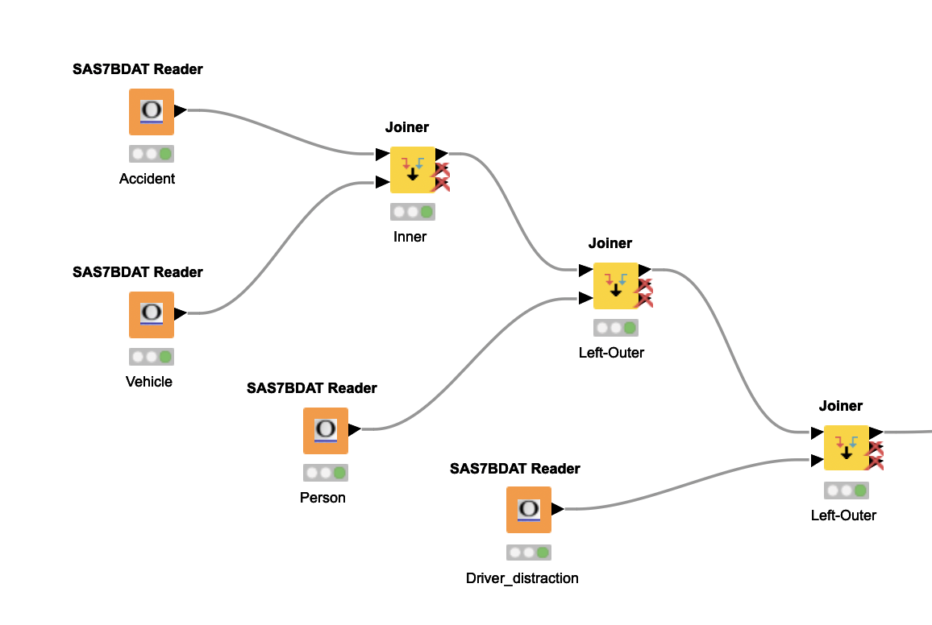
Data Collection
Data is consolidated from the four distinct SAS files (Accident, Vehicle, Person, Distract) provided by National Highway Traffic Safety Administration (NHTSA).
128,589 unique person person rows
204 columns

Slide 13

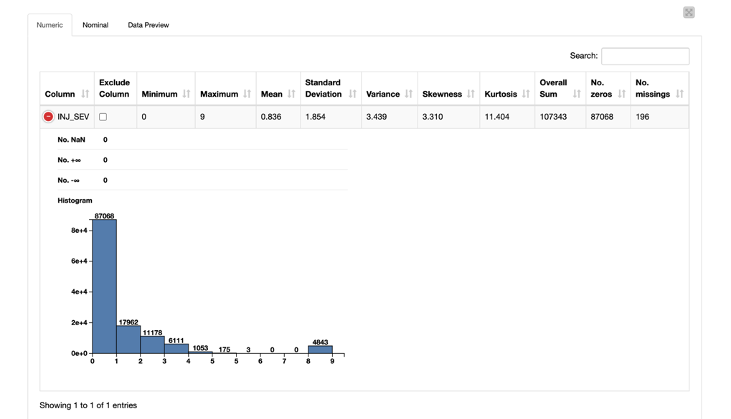
Data Description
198 Numeric and 6 Nominal features after consolidation.
Accident File : Details related to Accident (road conditions, environmental conditions , number of vehicles involved etc.. ).
Vehicle File : Details related to Vehicle characteristics (Model, Body type, weight etc..).
Person File : Details related person characteristics (demographics, injury and situational information about the occupants etc..) .
Distract File : Details about driver distraction.
Data Exploration
Thorough examination and exploratory analysis of the dataset uncover patterns, trends, and potential outliers, aiding in the identification of influential variables related to injury severity in road accidents.

Slide 14
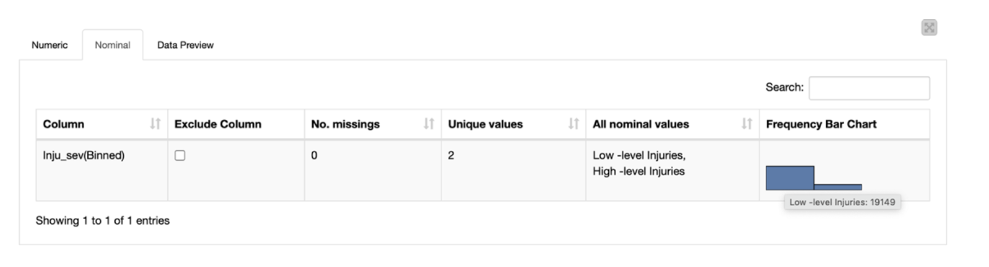
Data Quality Verification
There are many missing values, anomalies, and inconsistencies, found during the data exploration.
Furthermore, a notable observation is the imbalance in the distribution of the target variable is found .
Indicating lot of cleaning need to done.

Slide 15

Data Preparation

Slide 16

Data Preparation
Tasks involved:
Selecting Data
Cleaning Data
Constructing Data
Formatting Data

Slide 17
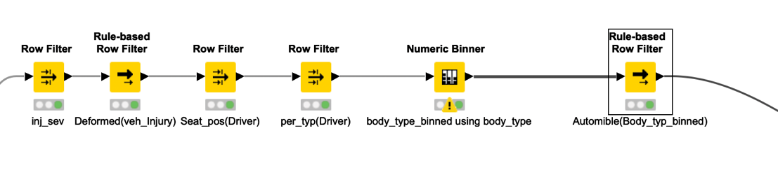
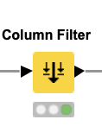
Selecting Data
Row Filtering
Aim is to enhance the homogeneity of the dataset.
Final rows: 23636
Feature Selection
Final Columns: 29

Slide 18
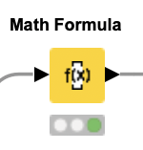
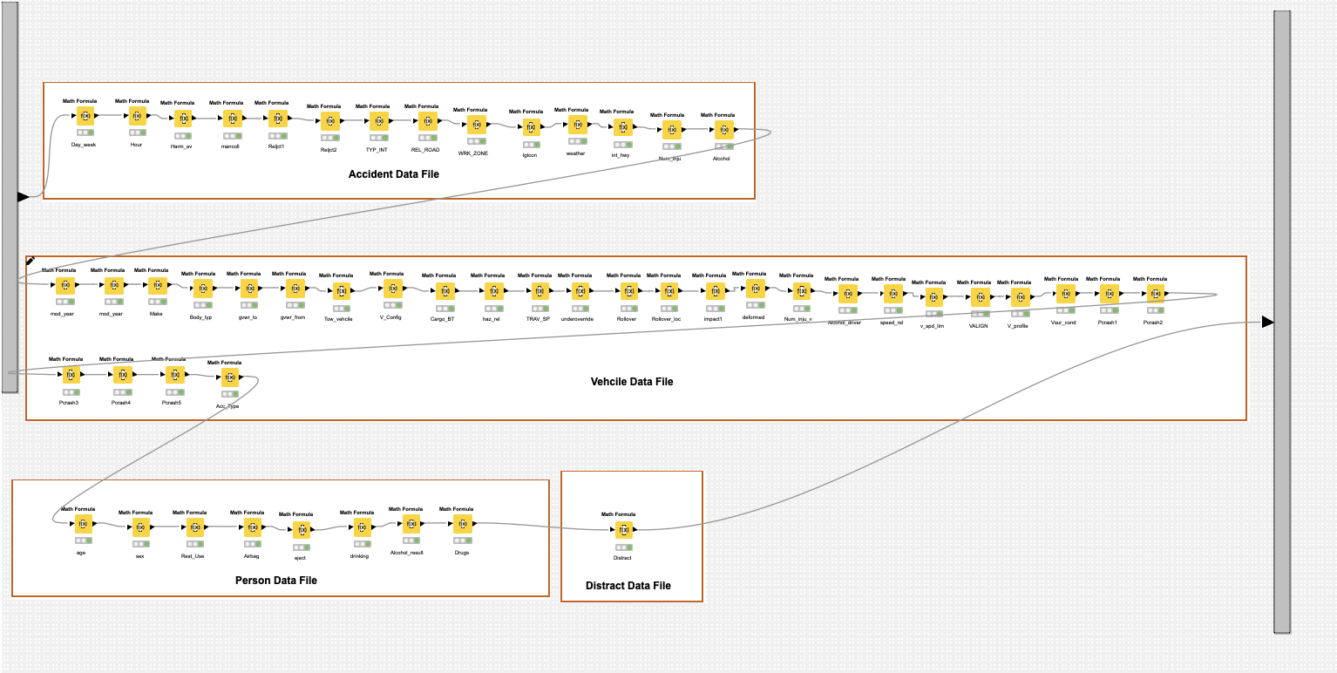
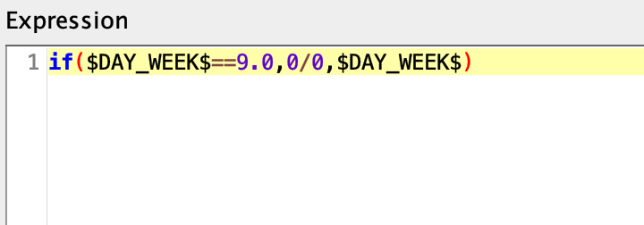
Cleaning Data
This step involves handling missing data, dealing with outliers (either by imputing or removing them), addressing anomalies, and encoding the data in a way suitable for the model.
Data Replacement

Slide 19
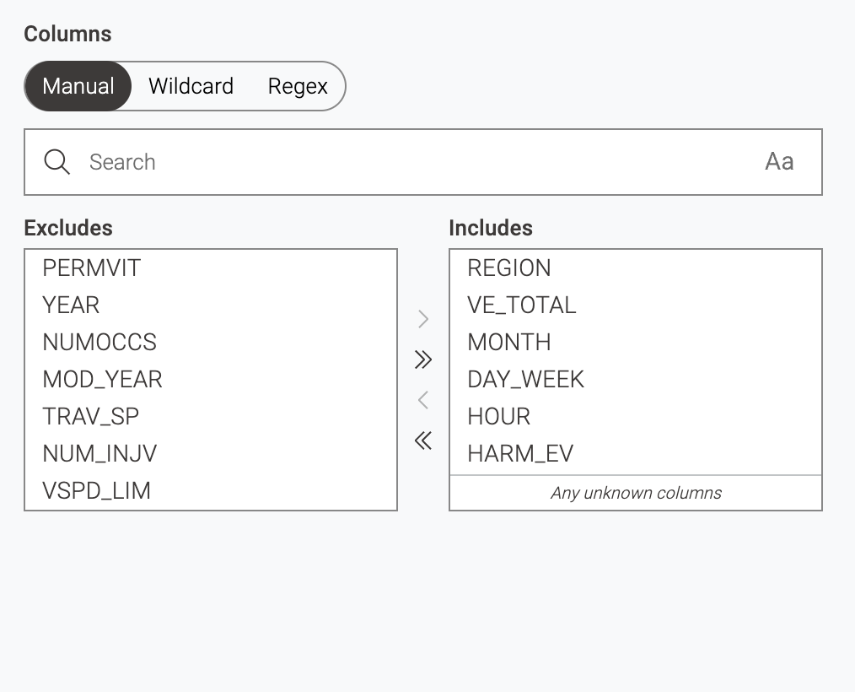
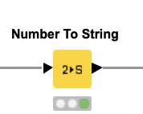
Cleaning Data
Datatype Conversion
Knime's default treatment of nominal (categorical) values as numeric (double) prompted the need for corrective action. To rectify this, we employed the Number to String Node in Knime.

Slide 20
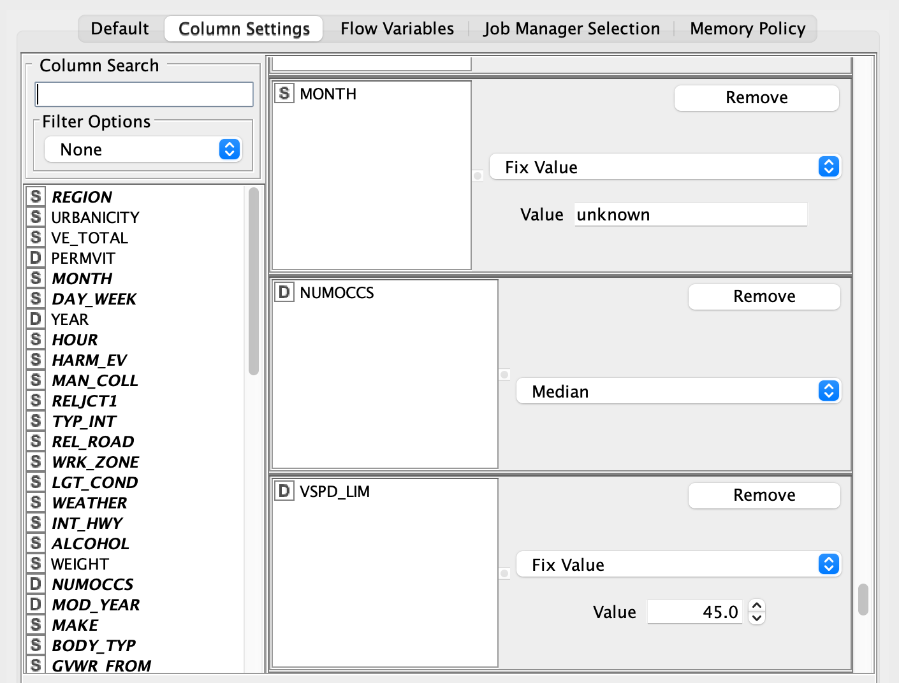
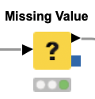
Cleaning Data
Imputations

Slide 21
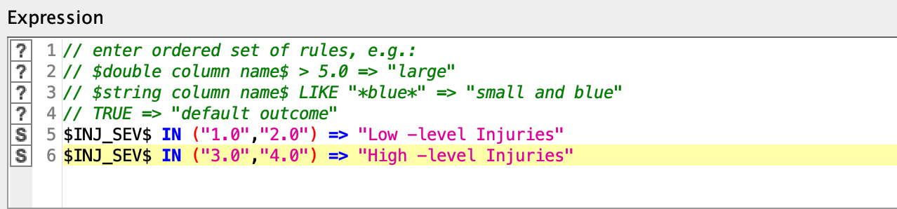
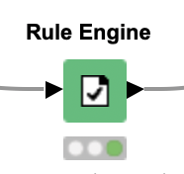
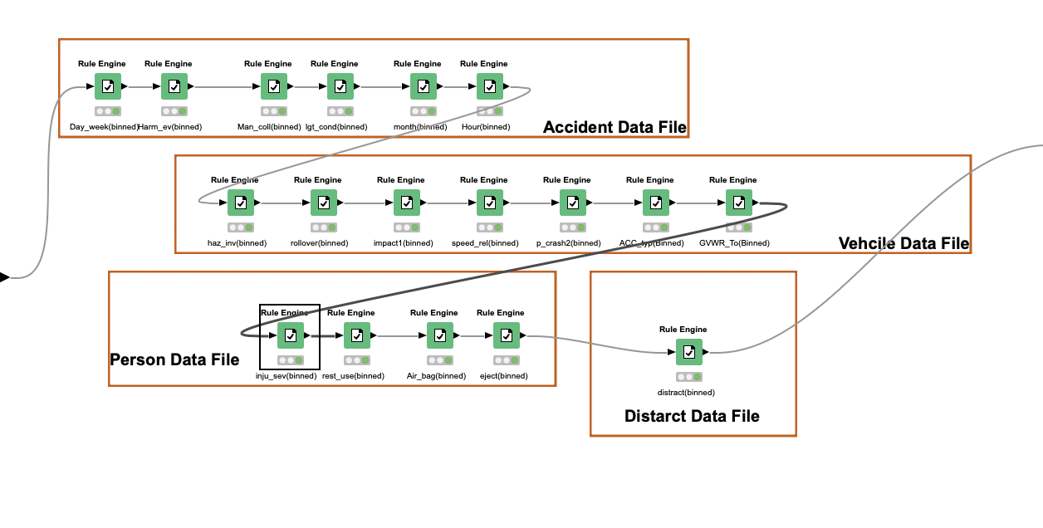
Cleaning Data
Binning/Grouping

Slide 22
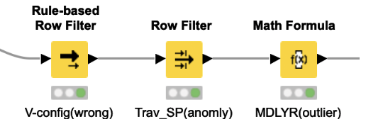
Cleaning Data
Handling Outliers
Variable | Outliers observed | Handling outlier
V_CONFIG | V_CONFIG =20 or V_CONFIG =21 These rows do not seem to be matching with the Body_typ as described in the manual | Removed outlier rows
TRAV_SP | One value (152.0) | Removed outlier row
Not injured | Values Less than 0 | Removed outlier rows
MOD_YEAR | 2022 | Changed them to 2021 though they are considered to be 2022 as this put Age vehicle negative values which is not true

Slide 23
Constructing Data
Variable | Datatype | Derived From | Description
Age_Vehcile | Numeric | YEAR, MOD_YEAR | Tells the Age of the Vehicle
Relative Speed | Numeric | TRAV_SP,VSPD_LIM | Speed of the vehicle relative to speed limit
Not Injured | Numeric | NUMOCCS,NUM_INJV | Number of people in the vehicle that are not injured

Slide 24
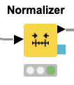
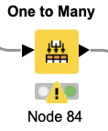
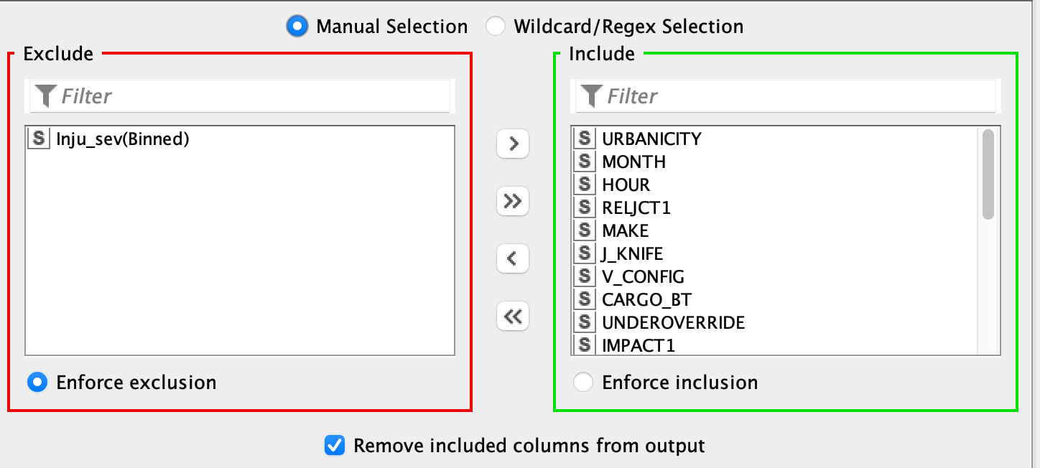
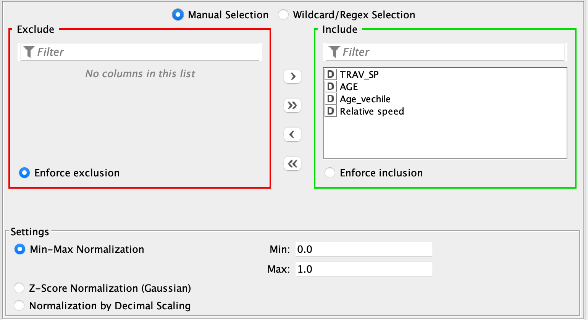
Formatting Data:
Transforms x to y= (x-min)/(max-min)

Slide 25
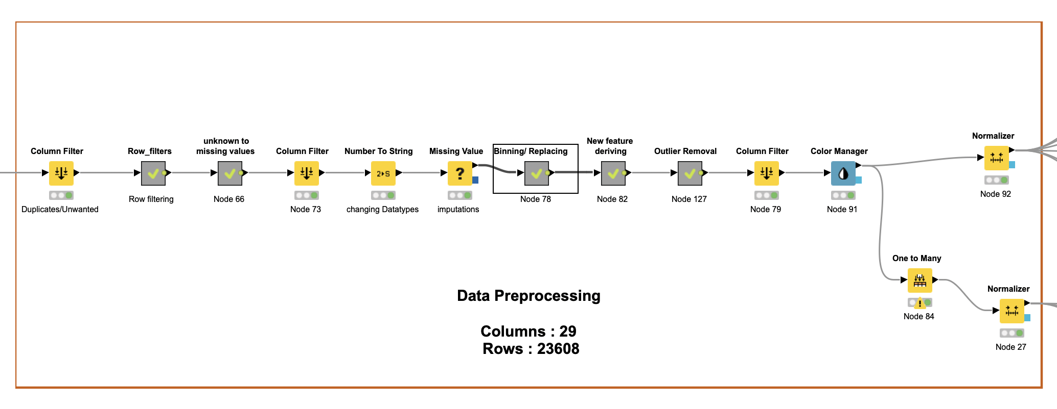
Data Preparation

Slide 26
Variables | Data type | Statistics
URBANICITY | Binary | Mode: 1.0
MONTH | Nominal | Mode: 10.0
HOUR | Nominal | Mode: 17.0
RELJCT1 | Nominal | Mode: 0.0
MAKE | Nominal | Mode: 20.0
J_KNIFE | Nominal | Mode: 0.0
V_CONFIG | Nominal | Mode: 0.0
CARGO_BT | Nominal | Mode: 0.0
TRAV_SP | Numeric | Mean:28.179 ,SD:16.93
UNDEROVERRIDE | Nominal | Mode: 0.0
IMPACT1 | Nominal | Mode: 12.0
DEFORMED | Nominal | Mode: 6.0
VPROFILE | Nominal | Mode: 1.0
P_CRASH1 | Nominal | Mode: 1.0
AGE | Numeric | Mean:40.947,SD:17.488
SEX | Nominal | Mode: 1.0
DRINKING | Nominal | Mode: 0.0
DRUGS | Nominal | Mode: unknown
BODY_TYP_binned | Nominal | Mode: 1.0
P_CRASH2(Binned) | Nominal | Mode: VT
ACC_TYP(Binned) | Nominal | Mode: 2D
GVWR_TO(Binned) | Nominal | Mode: Less weight
Inju_sev(Binned) - Dependent | Binary | Mode: Low level injuries
Rest_use(Binned) | Binary | Mode: yes
Air_Bag(Binned) | Binary | Mode: Deployed
Eject(Binned) | Binary | Mode: Not Ejected
Distract(Binned) | Nominal | Mode: unknown
Age_vechile | Numeric | Mean:8.214 , SD:6.961
Relative speed | Numeric | Mean:-16.327 ,SD:17.877

Slide 27

Modeling

Slide 28
Modeling
Tasks Involved:
Selecting Model techniques
Generate Test Design
Building Model

Slide 29
Selecting Model Techniques
Set-based models:
Decision tree (DT)
Random Forest(RF)
Gradient Boosted Trees(GBT)
Naïve Bayes(NB)
Number-based models:
Artificial neural networks(ANN),
Logistic Regression(LR)

Slide 30
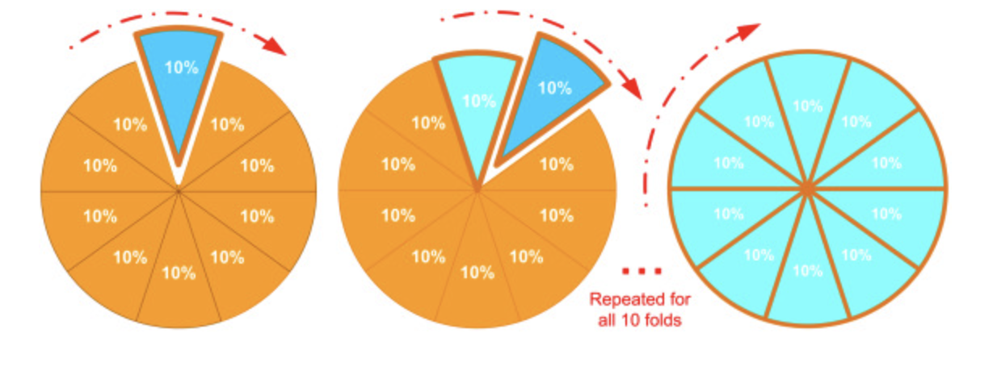
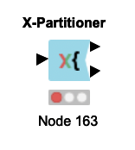
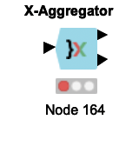
Generate Test Design
K-fold cross validation(K=10)

Slide 31
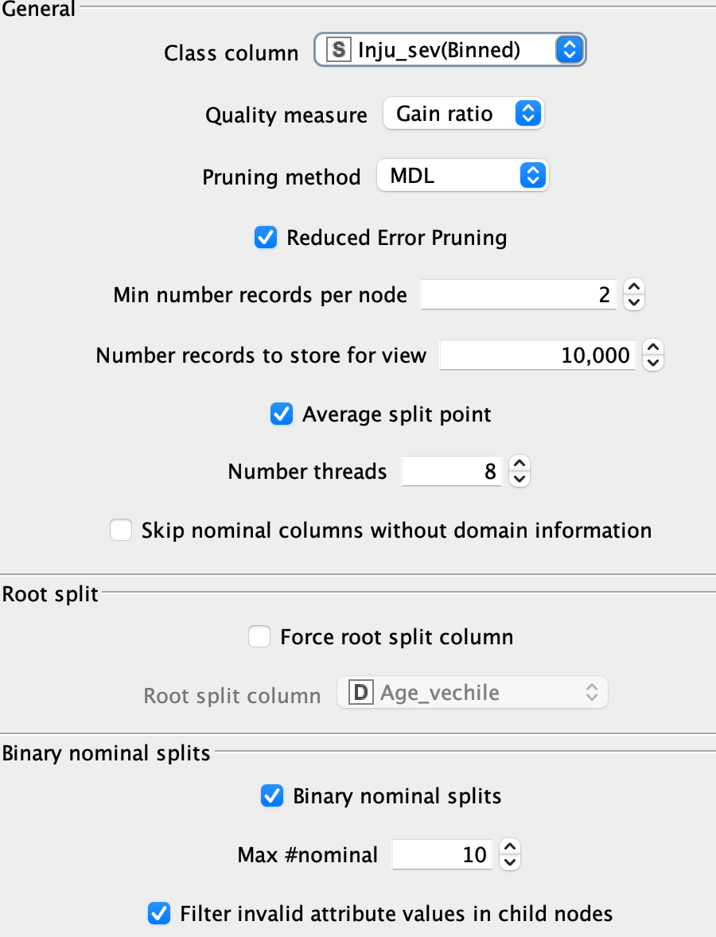
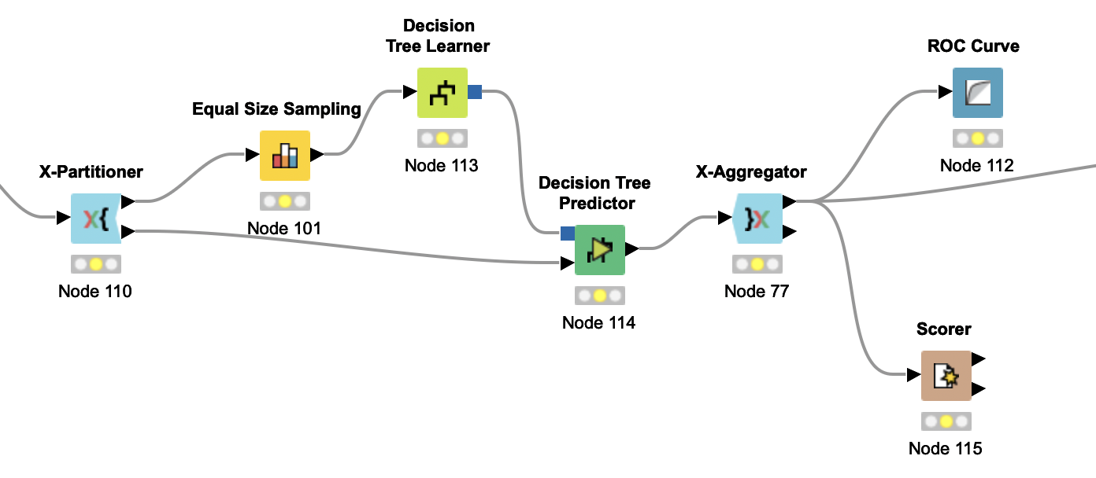
Building Model
Decision Tree

Slide 32
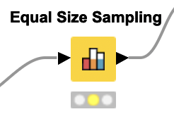
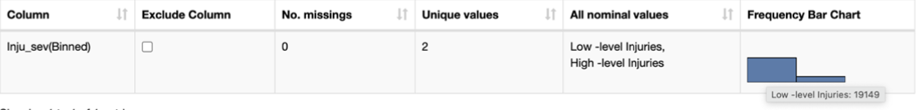
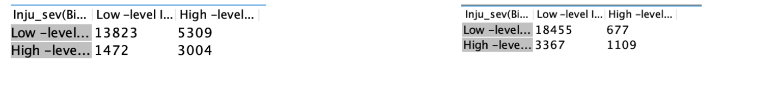
Building Model
Equal Size Sampling
Results with Balancing Results Without Balancing

Slide 33
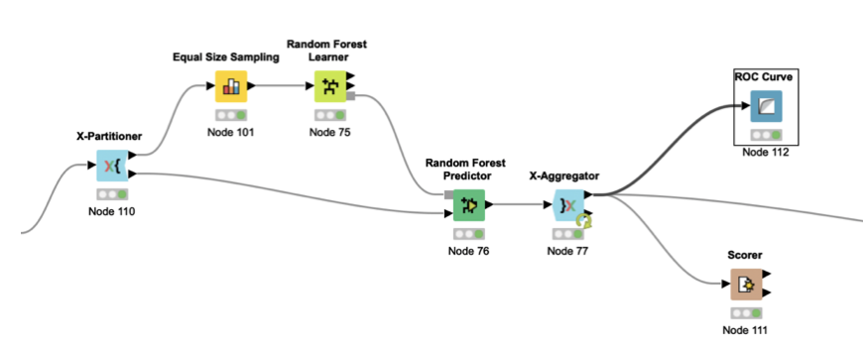
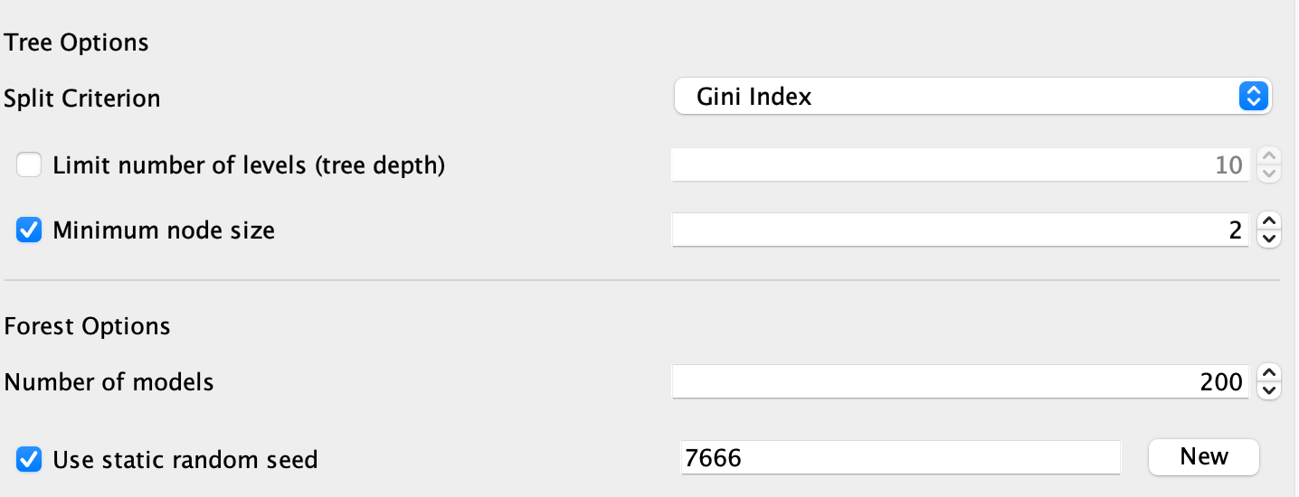
Building Model
Random Forest
To maintain pseudo randomness during training the model we used fixed random seed =7666 for all the models

Slide 34
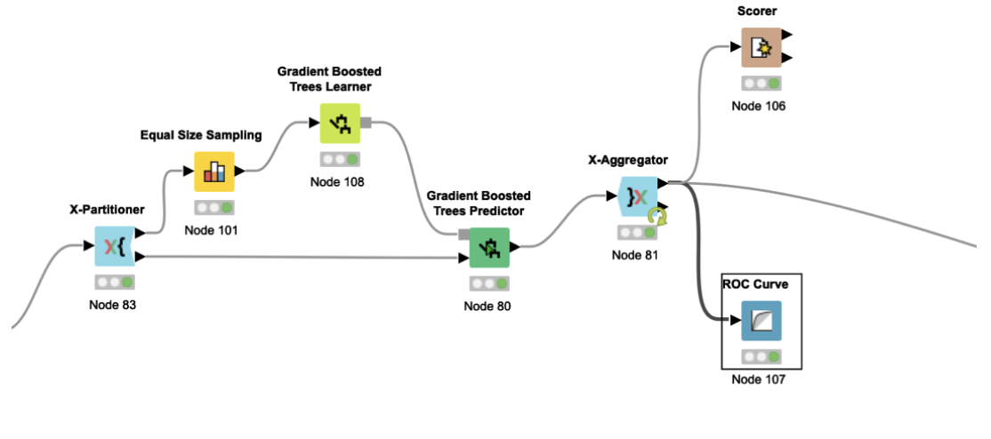
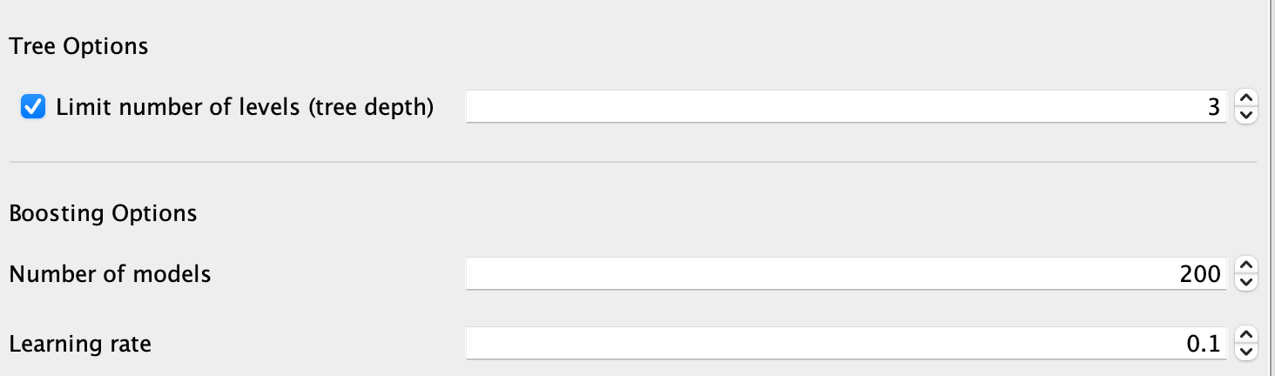
Building Model
Gradient Boosted Model

Slide 35
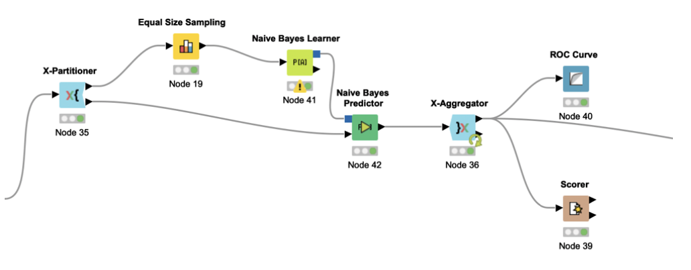
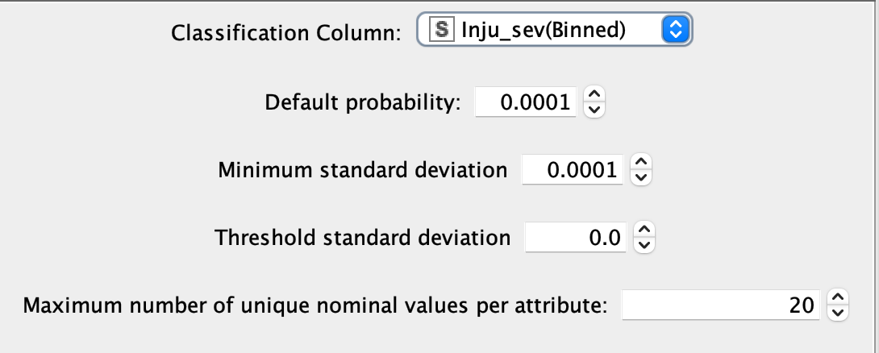
Building Model
Naives Bayes

Slide 36
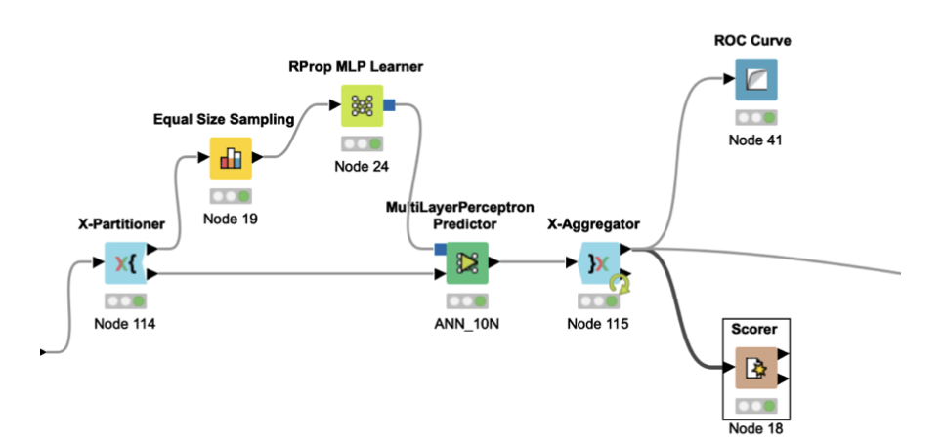
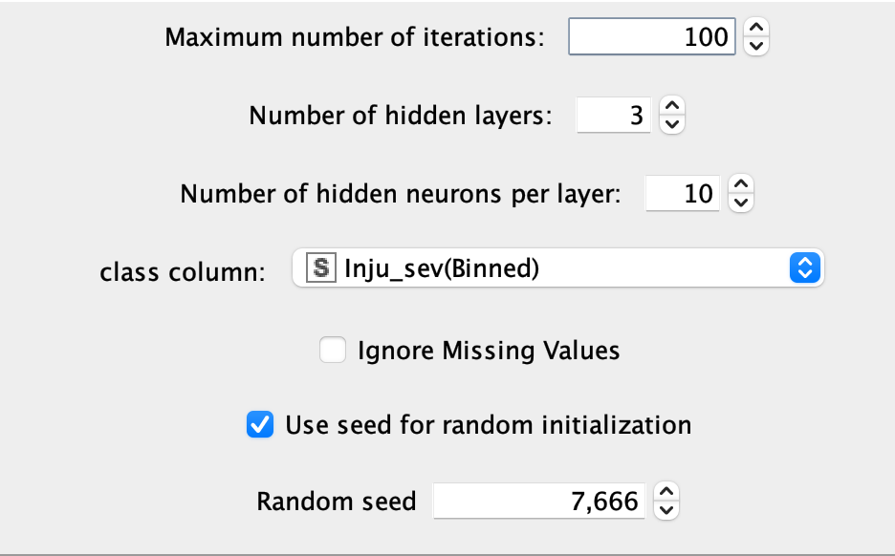
Building Model
ANN- Multilayer Perceptron

Slide 37
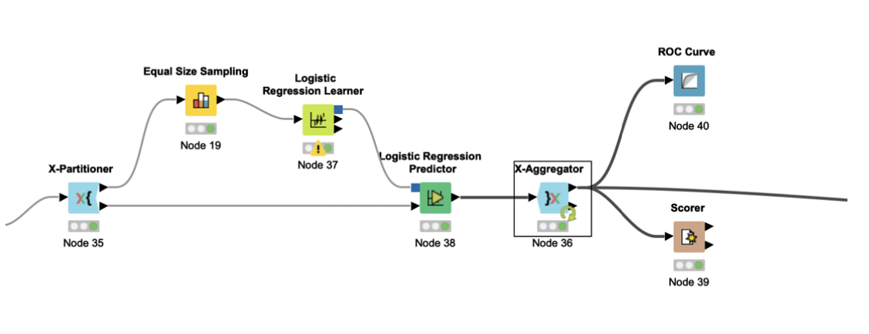
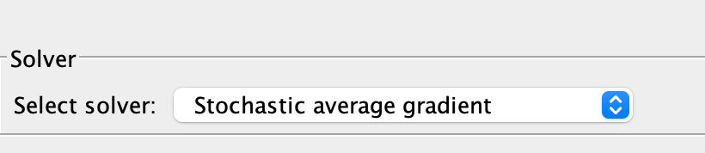
Building Model
Logistic Regression

Slide 38
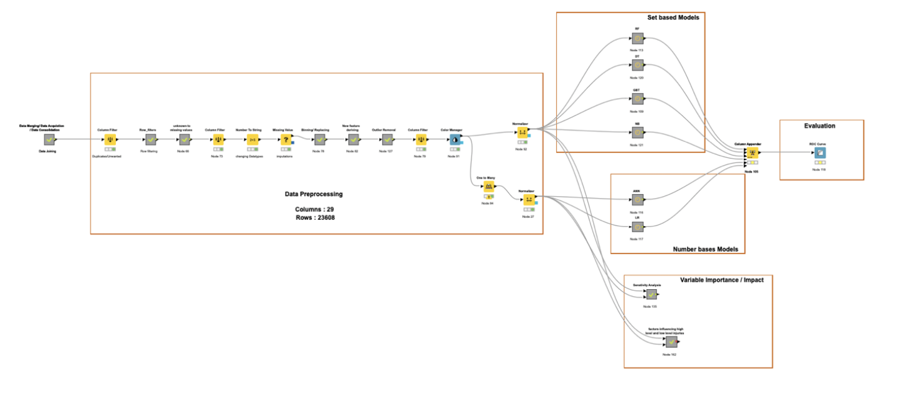

Slide 39

Evaluation

Slide 40

Evaluation
Tasks Involved:
Evaluation Results
Combined ROC
Variable Importance using sensitivity analysis

Slide 41
Evaluation Results
Model Type | AUC | ACCURACY | SENSTIVITY | SPECIFICITY
Random Forest(RF) | 0.793 | 81.01% | 0.88 | 0.56
Decision Tree(DT) | 0.742 | 71.3% | 0.723 | 0.671
Gradient Boosted Trees(GBT) | 0.799 | 73.1% | 0.738 | 0.703
Naïve Bayes (NB) | 0.773 | 73% | 0.747 | 0.66
Artificial Neural Networks(ANN-MLP) | 0.730 | 68.7% | 0.692 | 0.669
Logistic Regression (LR) | 0.796 | 73.28% | 0.738 | 0.707

Slide 42
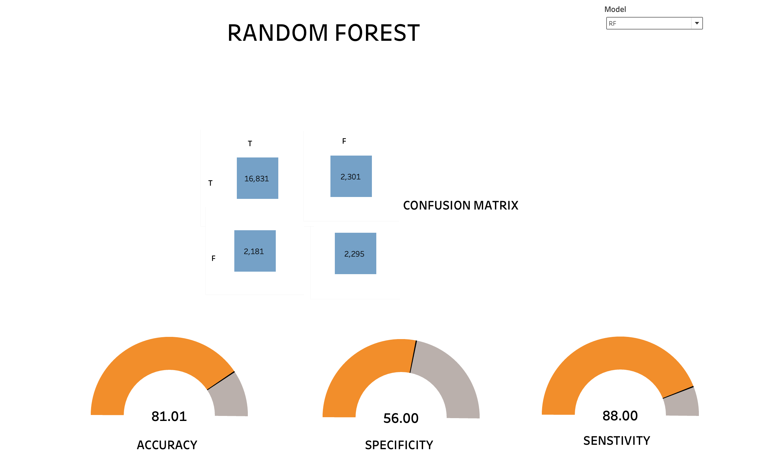
Evaluation Results

Slide 43
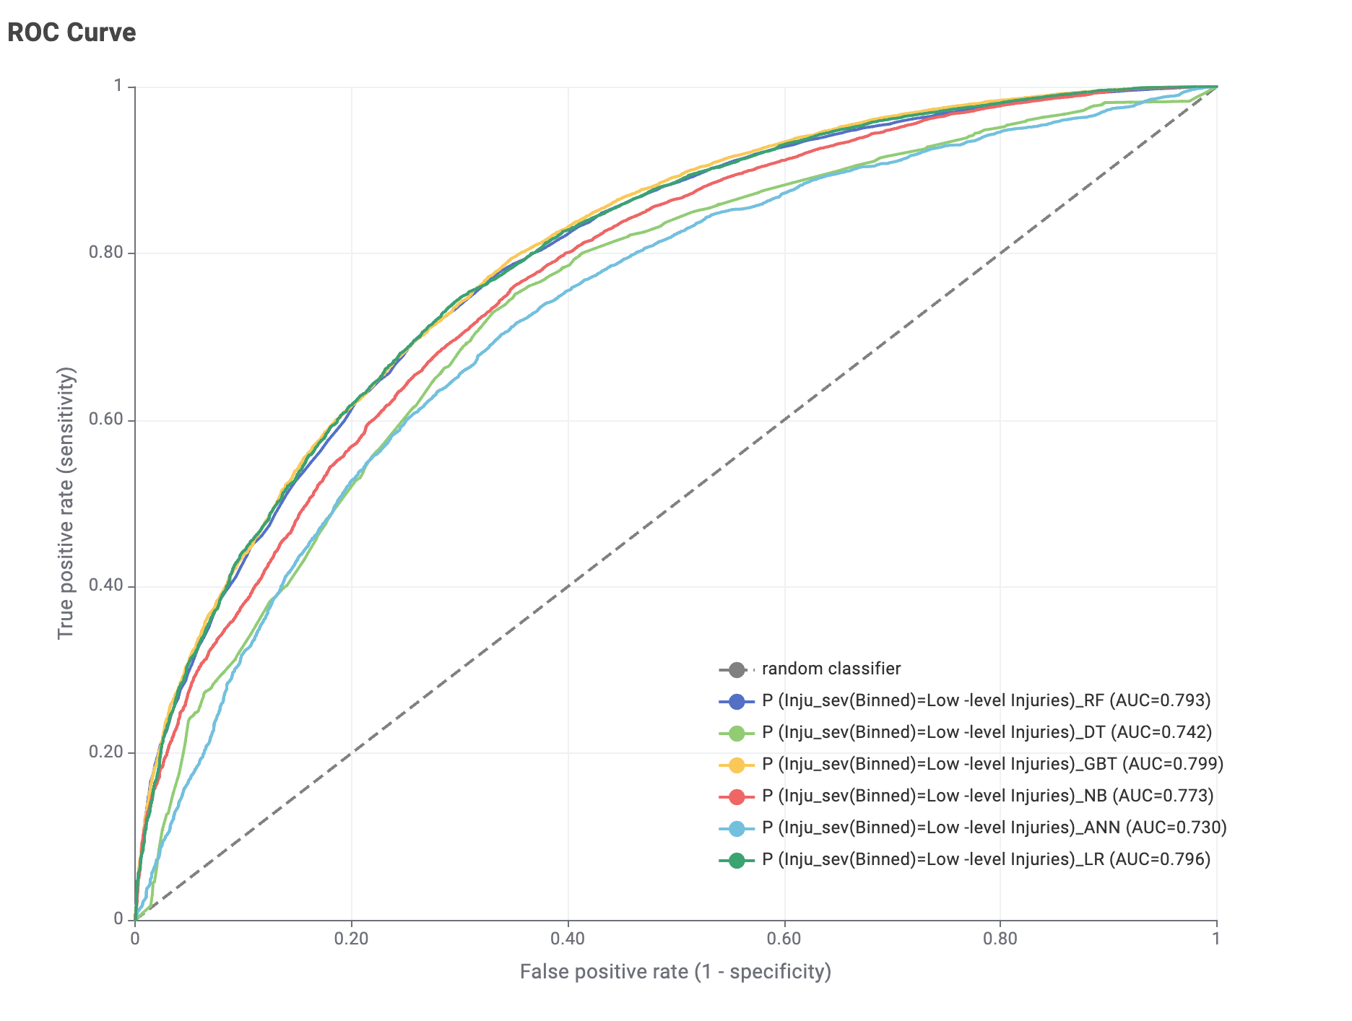
Combined ROC

Slide 44
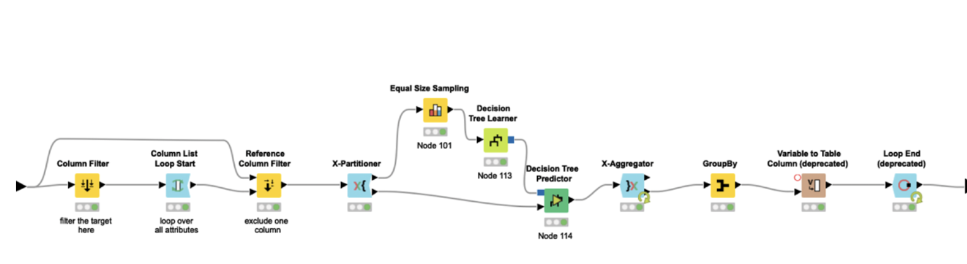
Variable Importance using Sensitivity Analysis
Why ?

Slide 45
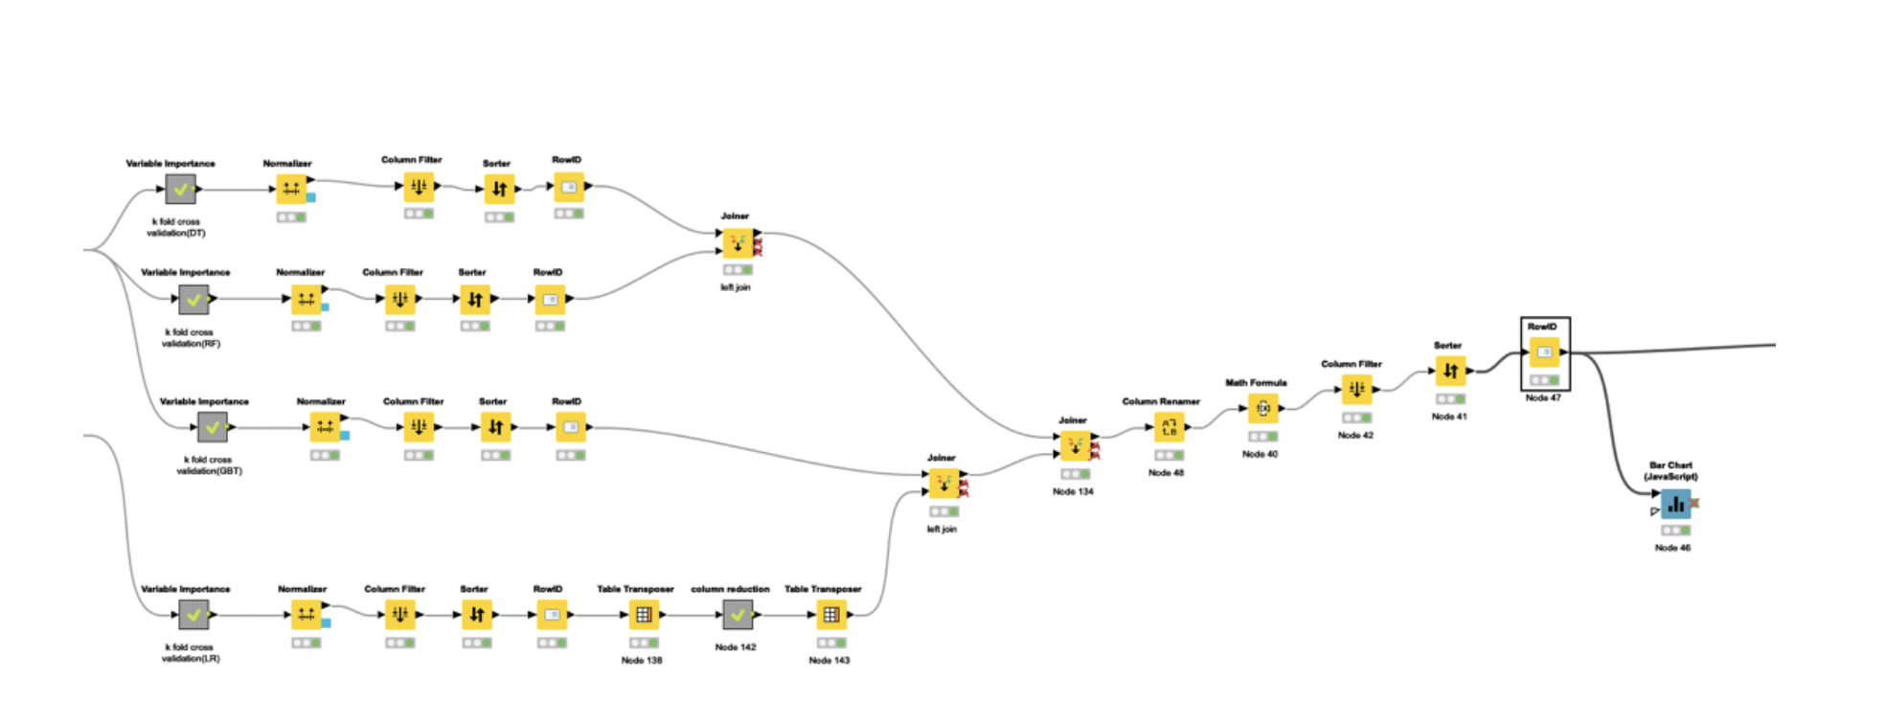
Variable Importance using Sensitivity Analysis
RF_W = weight of RF = (RF Accuracy / Total Accuracy) DT_W = weight of DT = (DT Accuracy / Total Accuracy) LR_W = weight of LR = (LR Accuracy / Total Accuracy) NB_W = weight of NB = (NB Accuracy / Total Accuracy)
Ensembled Variable Importance = (RF_VI * RF_W) + (DT_VI * DT_W) + (NB_VI * NB_W) + (LR_VI * LR_W)

Slide 46
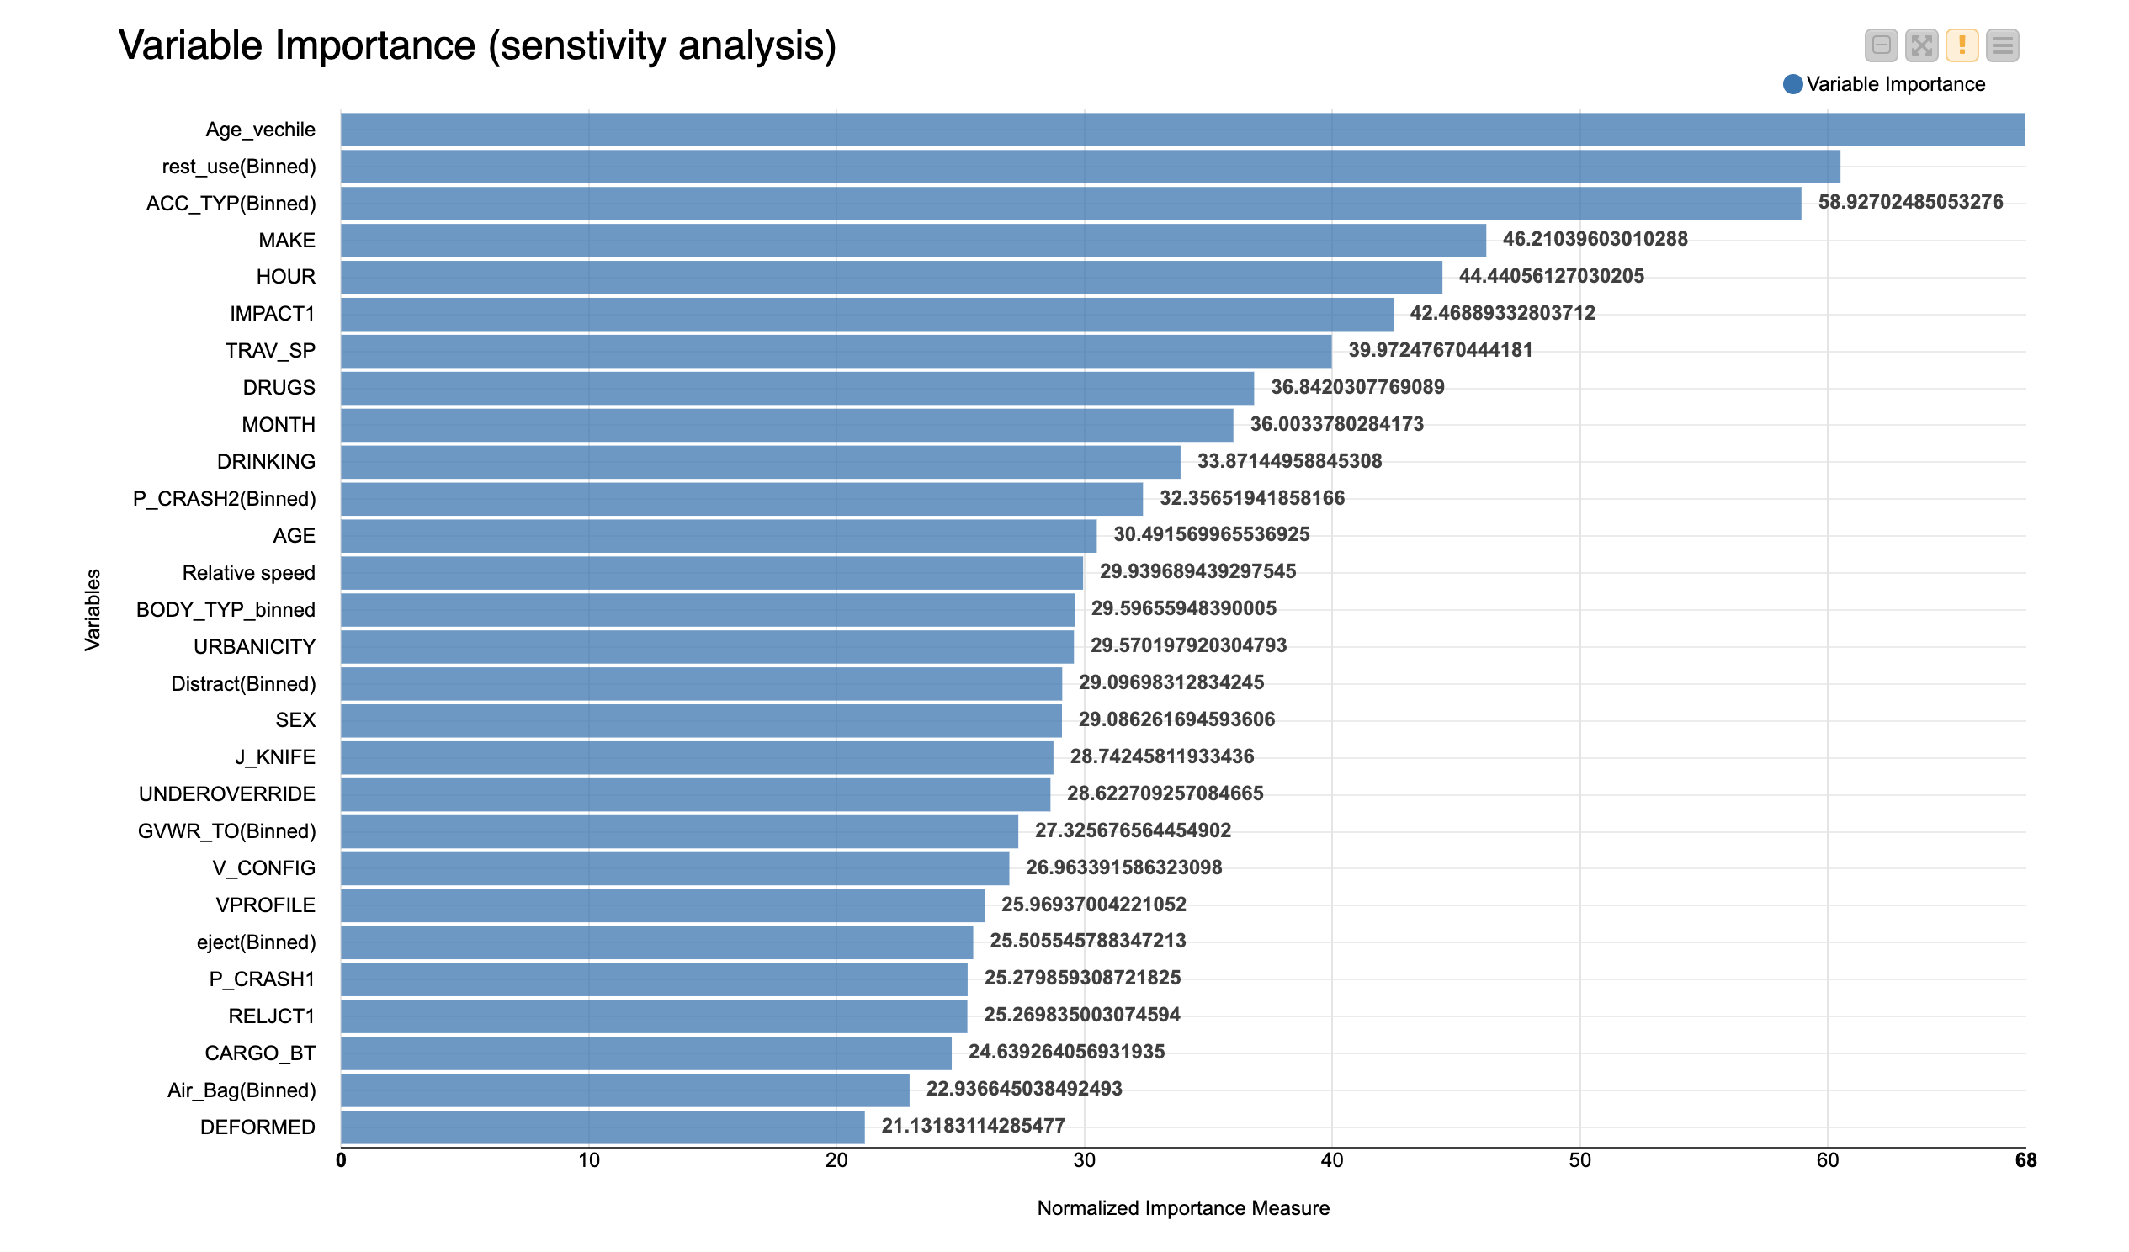
Variable Importance using Sensitivity Analysis

Slide 47
Variable Importance using Sensitivity Analysis
Highest
Group1(Age_vehcile,Rest_used(Binned),ACC_TYPE,MAKE)
Group 2 (HOUR, Impact1, Trav_sp, Drugs)
Group 3 (MONTH, Drinking, P_CRASH2 (Binned), Age)
Group 4 (RELJCT1, CARGO_BT, Airbag (Binned), Deformed)
But this only covers about the factors influencing the driver injuries(collective) but not on the level of severity .
Lowest

Slide 48
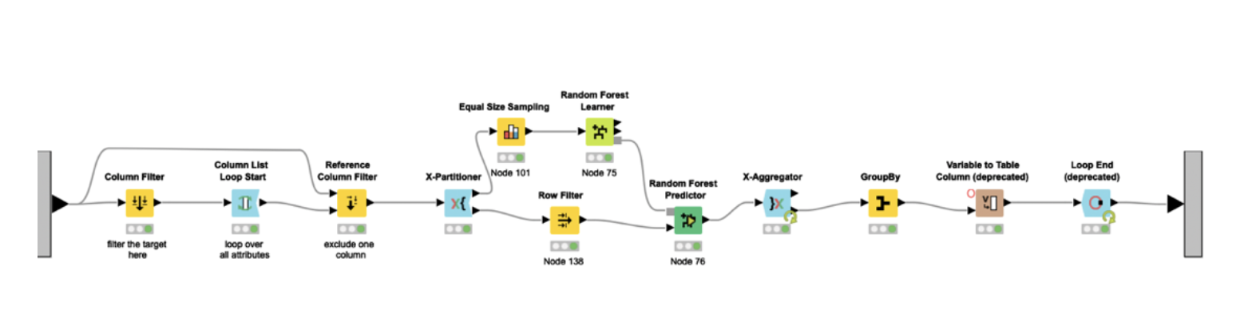
Variable Importance using Sensitivity Analysis
Since our aim is to identify risk factors that impact severity of driver injuries, we further classified the risk factors for high-level and low-level .

Slide 49
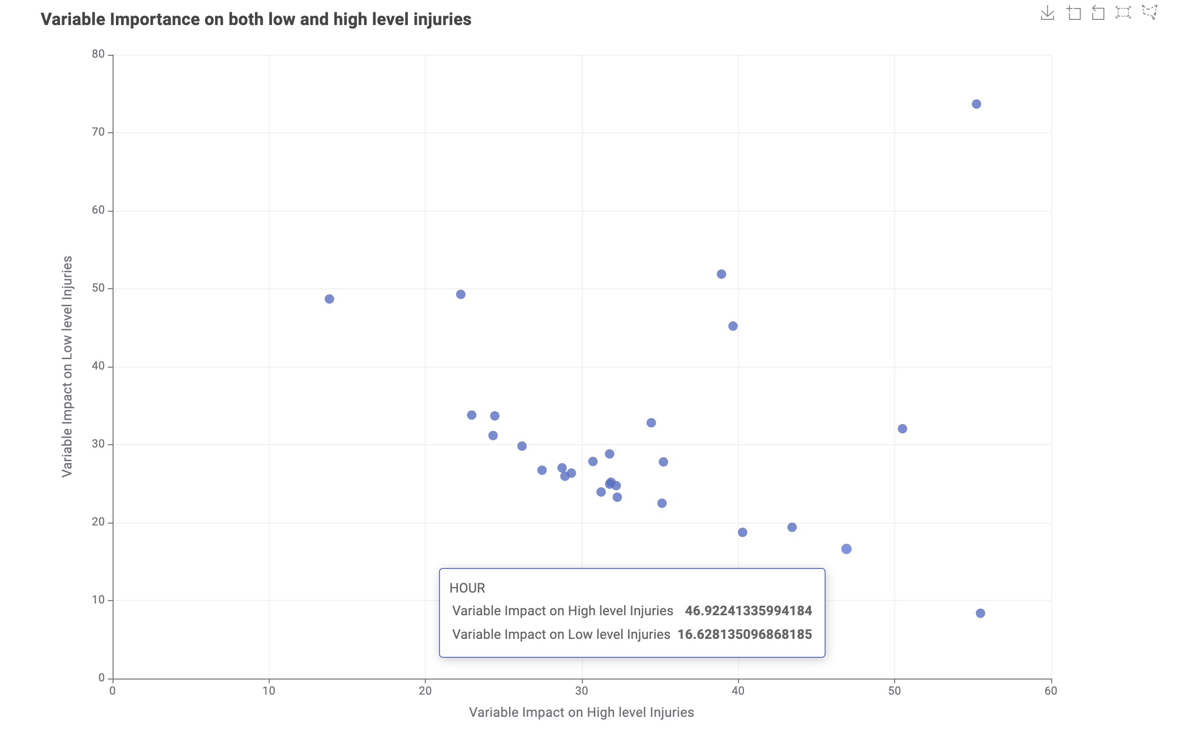
Variable Importance using Sensitivity Analysis

Slide 50
Variable Importance using Sensitivity Analysis
Factors (TOP) Influencing Minor-Level Injuries:
Deformed
Age
Airbag (Binned)
Eject (Binned)
Factors(TOP) Influencing Major-Level Injuries:
Age_Vehcile
MONTH
IMPACT1
HOUR
Rest_used
Make

Slide 51

Deployment

Slide 52
Deployment
In the deployment phase of CRISP-DM, insights from the analysis of automobile crashes and injury severity are organized, formatted, and presented.
Could not be maintained in academic environment.
Key steps include systematically organizing knowledge, preparing clear presentations for stakeholders, enhancing accessibility through visualizations, engaging with government and corporate entities, integrating regulations.
Among the various models employed, the Random Forest Model has emerged as our standout performer. We urge and hope to use our analysis for decreasing the risks of injuries.

Slide 53
Conclusion
In conclusion, this study sheds light on crucial factors intricately tied to severe car crash injuries, offering valuable insights for various stakeholders.
Elements that emerged as significant influencers are:
Airbag and safety restraint usage, type of deformation in accidents, driver involvement in drinking or drug consumption, Age of the vehicle, Manufacturer of the car, Time of the vehicle usage(MONTH, Hour),IMPACT(area on the vehicle that produced the initial instance of injury ).
Suggestions
For drivers
Adopting proper safety measures, selecting vehicles with functional airbags, and avoiding impairing substances are emphasized, always use restraint system careful with old vehicles.
For Car manufacturers
Encouraged to invest in robust designs, integrate safety features, and advance intelligent driving systems to mitigate risks.
For Authorities
Enforcing strict surveillance on unsafe practices and emergency accident treatment..

Slide 54


